Slide 1

6th Grade Math Accelerated
Unit 4, Lesson 3 Points on the Coordinate Plane – Part 2 Volume 1, pg. 145

Slide 2


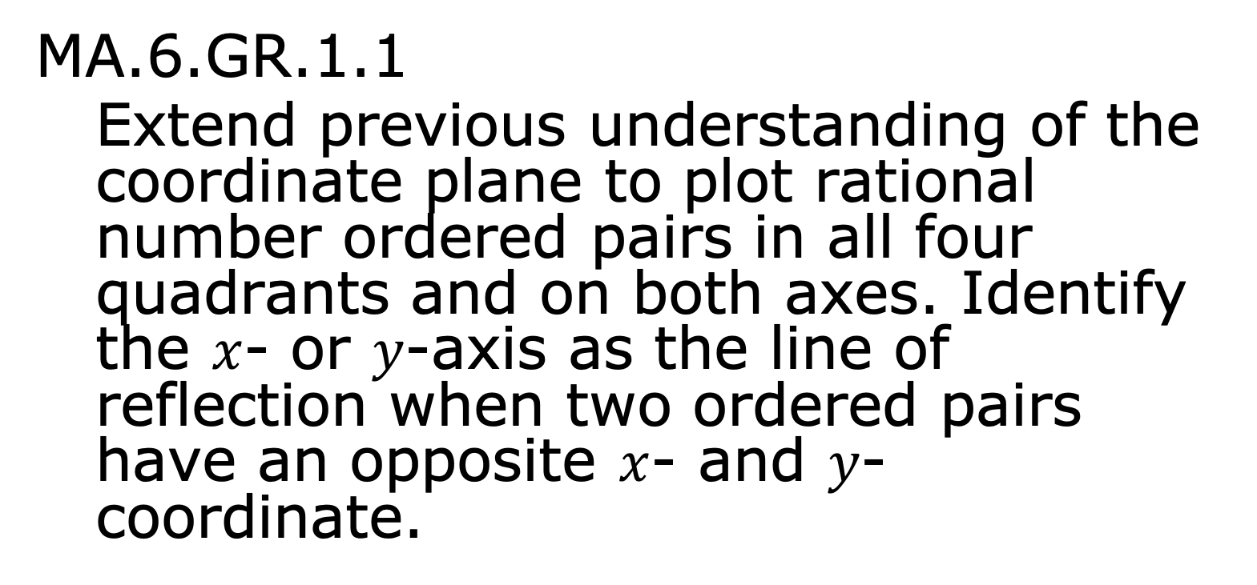
Benchmark
MA.6.GR.1.1
Extend previous understanding of the coordinate plane to plot rational number ordered pairs in all four quadrants and on both axes. Identify the $x$- or $y$-axis as the line of reflection when two ordered pairs have an opposite $x$- and $y$-coordinate.
volume 1, pg. 145

Slide 3
Integrated Mathematical Thinking and Reasoning Standards
MA.K12.MTR.1.1 Actively participate in effortful learning both individually and collectively.
MA.K12.MTR.3.1 Complete tasks with mathematical fluency.
MA.K12.MTR.4.1 Engage in discussions that reflect on the mathematical thinking of self and others.
MA.K12.MTR.6.1 Assess the reasonableness of solutions.
MA.K12.MTR.7.1 Apply mathematics to real-world contexts.
volume 1, pg. 145

Slide 4


Learning Target
I can plot rational numbers using a scale of $1$.
volume 1, pg. 145

Slide 5

Warm-Up
volume 1, pg. 146

Slide 6
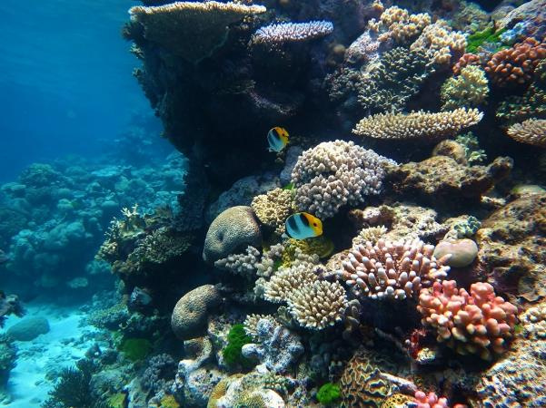
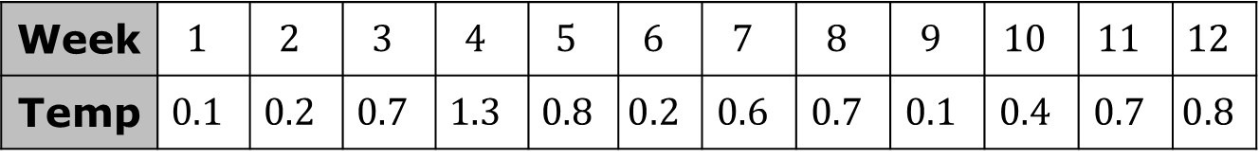
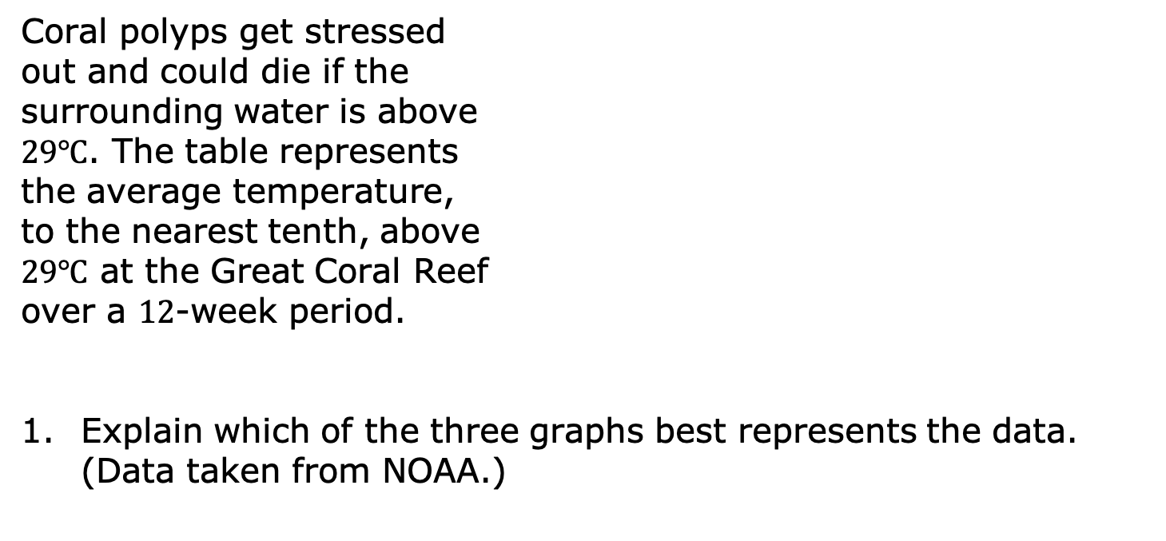
4.3.1 Warm-Up: Which One Is the Best?
Coral polyps get stressed
out and could die if the
surrounding water is above
$29℃$. The table represents
the average temperature,
to the nearest tenth, above
$29℃$ at the Great Coral Reef
over a $12$-week period.
Explain which of the three graphs best represents the data. (Data taken from NOAA.)
Week | $$1$$ | $$2$$ | $$3$$ | $$4$$ | $$5$$ | $$6$$ | $$7$$ | $$8$$ | $$9$$ | $$10$$ | $$11$$ | $$12$$
Temp | $$0.1$$ | $$0.2$$ | $$0.7$$ | $$1.3$$ | $$0.8$$ | $$0.2$$ | $$0.6$$ | $$0.7$$ | $$0.1$$ | $$0.4$$ | $$0.7$$ | $$0.8$$
volume 1, pg. 146

Slide 7
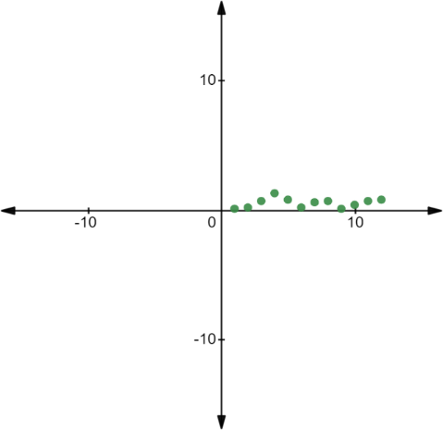
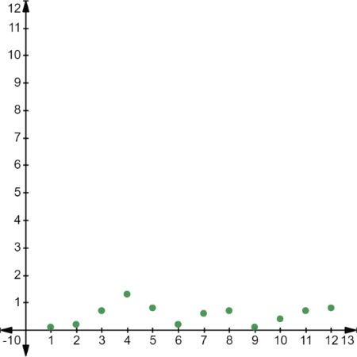
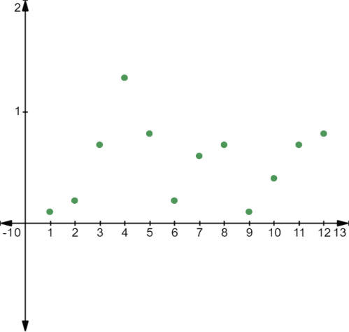
Graph A Graph B
Graph C
volume 1, pg. 146

Slide 8

Try It
volume 1, pg. 147

Slide 9

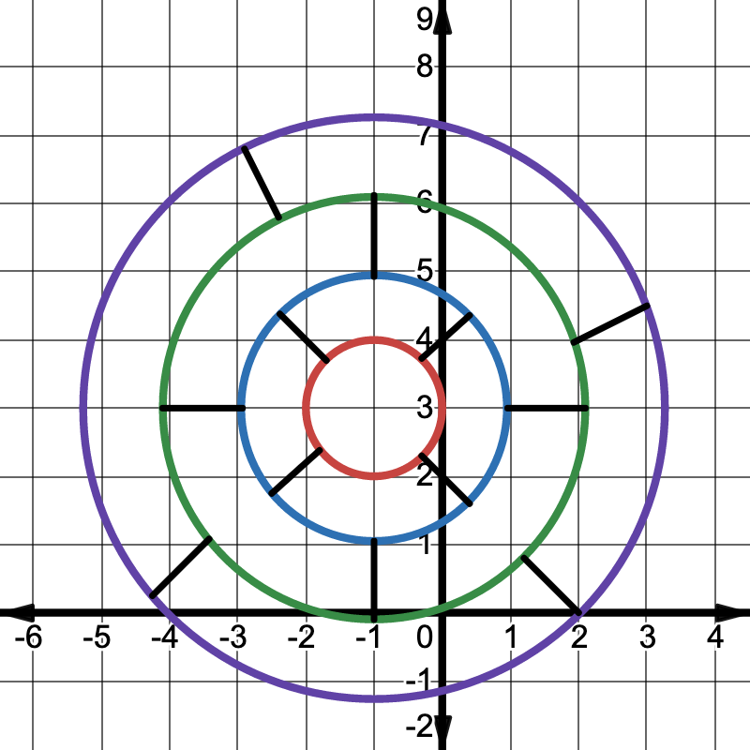
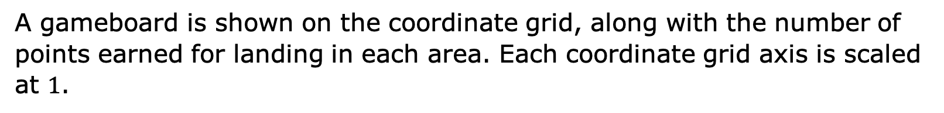
4.3.2 Try It: Game Score
A gameboard is shown on the coordinate grid, along with the number of points earned for landing in each area. Each coordinate grid axis is scaled at $1$.
volume 1, pg. 147

Slide 10
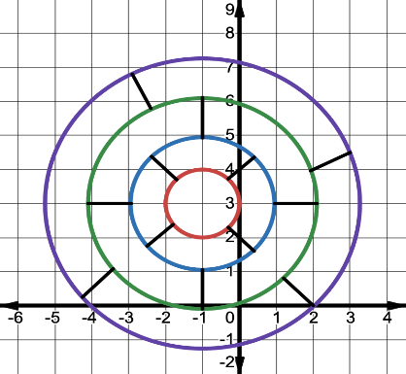
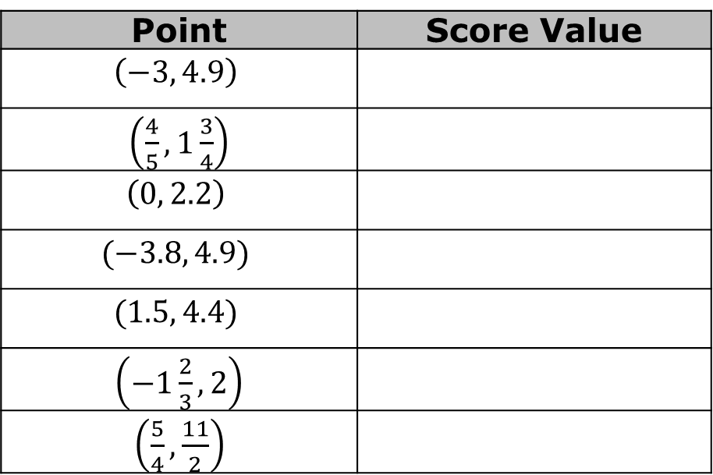
Several points are given in the table. Locate each point on the coordinate grid. Complete the table by writing the score value for landing at each point. Calculate the game score by finding the sum of all the points. Verify your answer with your teacher.
Game Score: ____________
Point | Score Value
$$\left(−3, 4.9\right)$$
$\left(\frac{4}{5}, 1\frac{3}{4}\right)$
$$\left(0, 2.2\right)$$
$$(−3.8, 4.9)$$
$$(1.5, 4.4)$$
$\left(−1\frac{2}{3}, 2\right)$
$\left(\frac{5}{4}, \frac{11}{2}\right)$
volume 1, pg. 147

Slide 11

Collaboration
volume 1, pg. 148

Slide 12


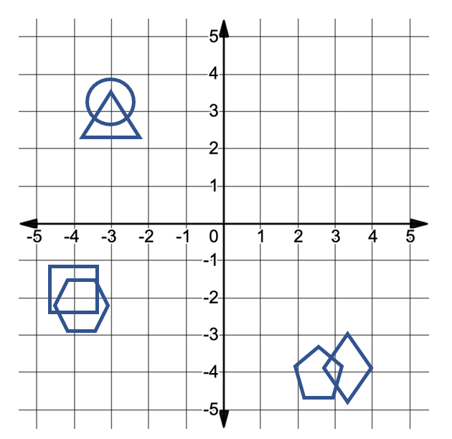
4.3.3 Collaboration: Hit or Miss
There are six shapes on the coordinate grid shown. Each partner will select one shape as their game piece. The object of the game is to guess which shape your partner selected before they guess yours. A hit means the point you guessed is inside their shape. A miss means that it is not. Keep your gameboard hidden from your partner during the game.
volume 1, pg. 148

Slide 13
The shape of the region I am picking is a ______________.
volume 1, pg. 148

Slide 14
Record the coordinates of each guess in the table below. Then, plot the point on the coordinate grid gameboard.
Partner 1 Guess | Was it a hit or miss? | Partner 2 Guess | Was it a hit or miss?
volume 1, pg. 148

Slide 15

Your Turn
volume 1, pg. 149

Slide 16
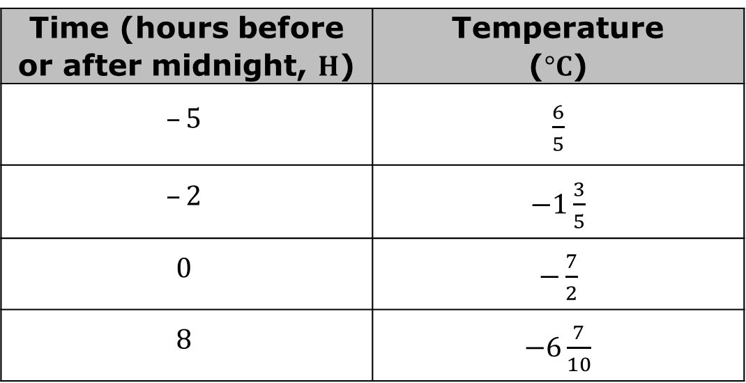
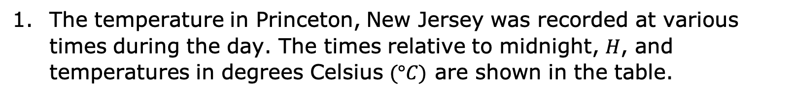
4.3.4 Your Turn!
The temperature in Princeton, New Jersey was recorded at various times during the day. The times relative to midnight, $H$, and temperatures in degrees Celsius $(°C)$ are shown in the table.
Time (hours before or after midnight, $H$) | Temperature ($°C$)
$$–5$$ | $\frac{6}{5}$
$$–2$$ | $−1\frac{3}{5}$
$$0$$ | $−\frac{7}{2}$
$$8$$ | $−6\frac{7}{10}$
volume 1, pg. 149

Slide 17
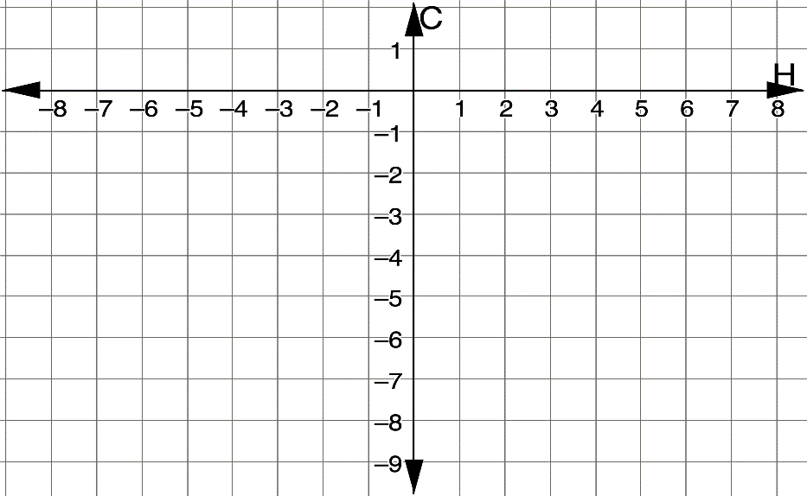
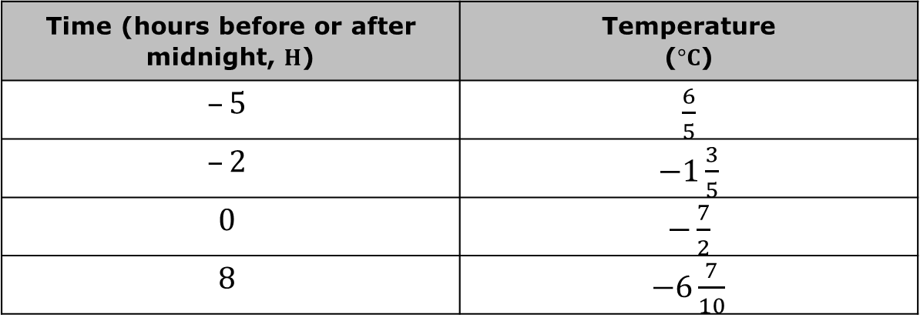
Time (hours before or after midnight, $H$) | Temperature ($°C$)
$$–5$$ | $\frac{6}{5}$
$$–2$$ | $−1\frac{3}{5}$
$$0$$ | $−\frac{7}{2}$
$$8$$ | $−6\frac{7}{10}$
Plot the points that represent the data.
volume 1, pg. 149

Slide 18
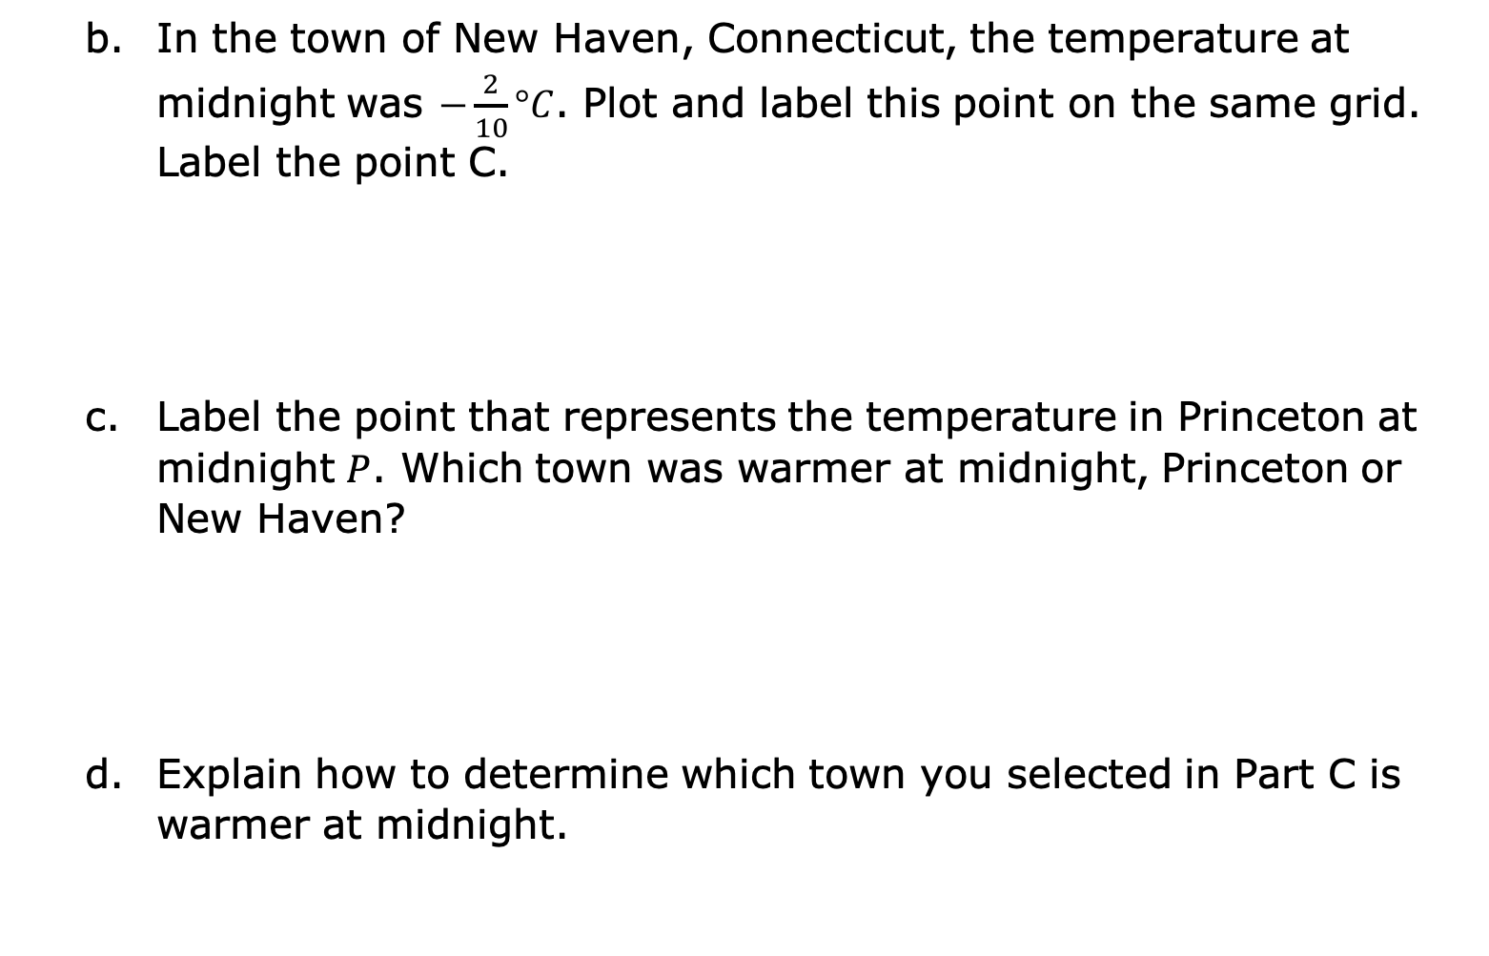
In the town of New Haven, Connecticut, the temperature at midnight was $−\frac{2}{10}°C$. Plot and label this point on the same grid. Label the point C.
Label the point that represents the temperature in Princeton at midnight $P$. Which town was warmer at midnight, Princeton or New Haven?
Explain how to determine which town you selected in Part C is warmer at midnight.
volume 1, pg. 149

Slide 19
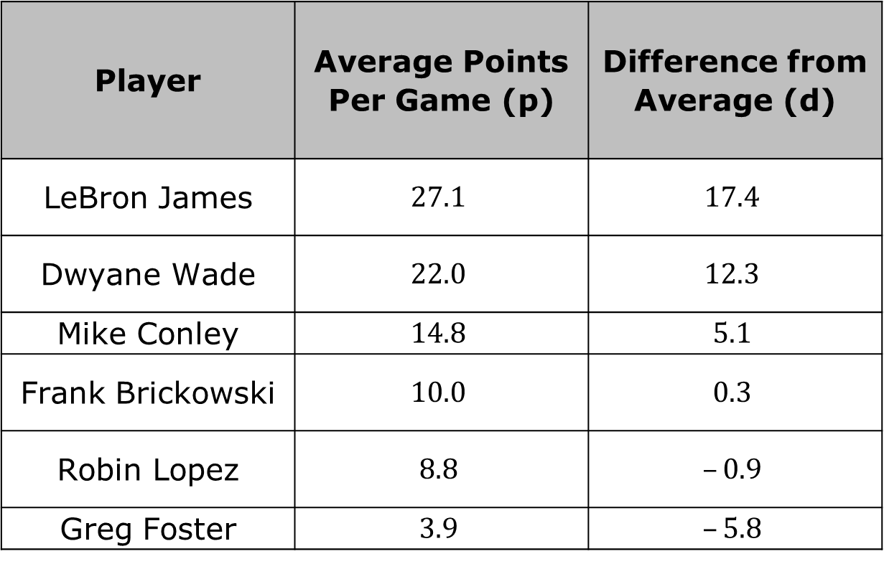
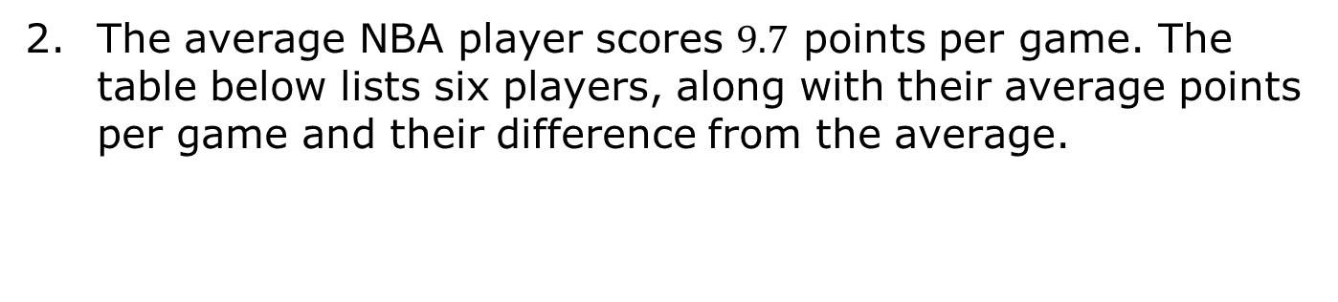
The average NBA player scores $9.7$ points per game. The table below lists six players, along with their average points per game and their difference from the average.
Player | Average Points Per Game (p) | Difference from Average (d)
LeBron James | $$27.1$$ | $$17.4$$
Dwyane Wade | $$22.0$$ | $$12.3$$
Mike Conley | $$14.8$$ | $$5.1$$
Frank Brickowski | $$10.0$$ | $$0.3$$
Robin Lopez | $$8.8$$ | $$–0.9$$
Greg Foster | $$3.9$$ | $$–5.8$$
volume 1, pg. 150

Slide 20
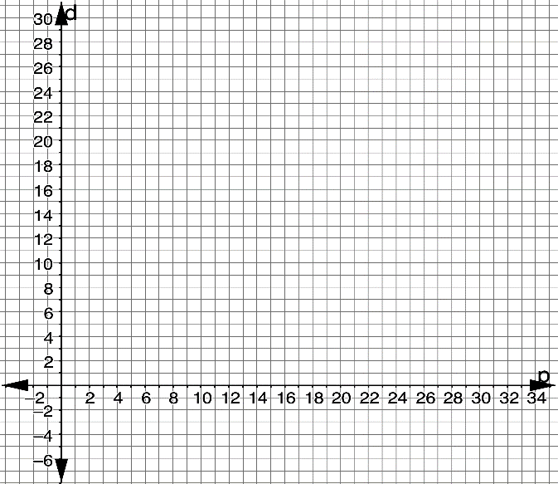
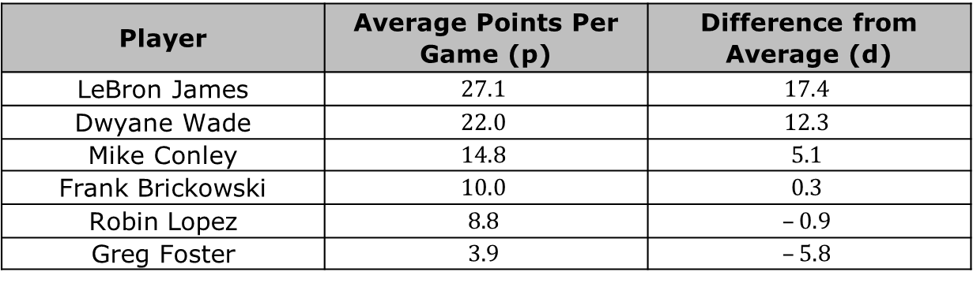
Player | Average Points Per Game (p) | Difference from Average (d)
LeBron James | $$27.1$$ | $$17.4$$
Dwyane Wade | $$22.0$$ | $$12.3$$
Mike Conley | $$14.8$$ | $$5.1$$
Frank Brickowski | $$10.0$$ | $$0.3$$
Robin Lopez | $$8.8$$ | $$–0.9$$
Greg Foster | $$3.9$$ | $$–5.8$$
Graph the points from the table on the coordinate grid.
volume 1, pg. 150

Slide 21

Wrap-Up
volume 1, pg. 150

Slide 22
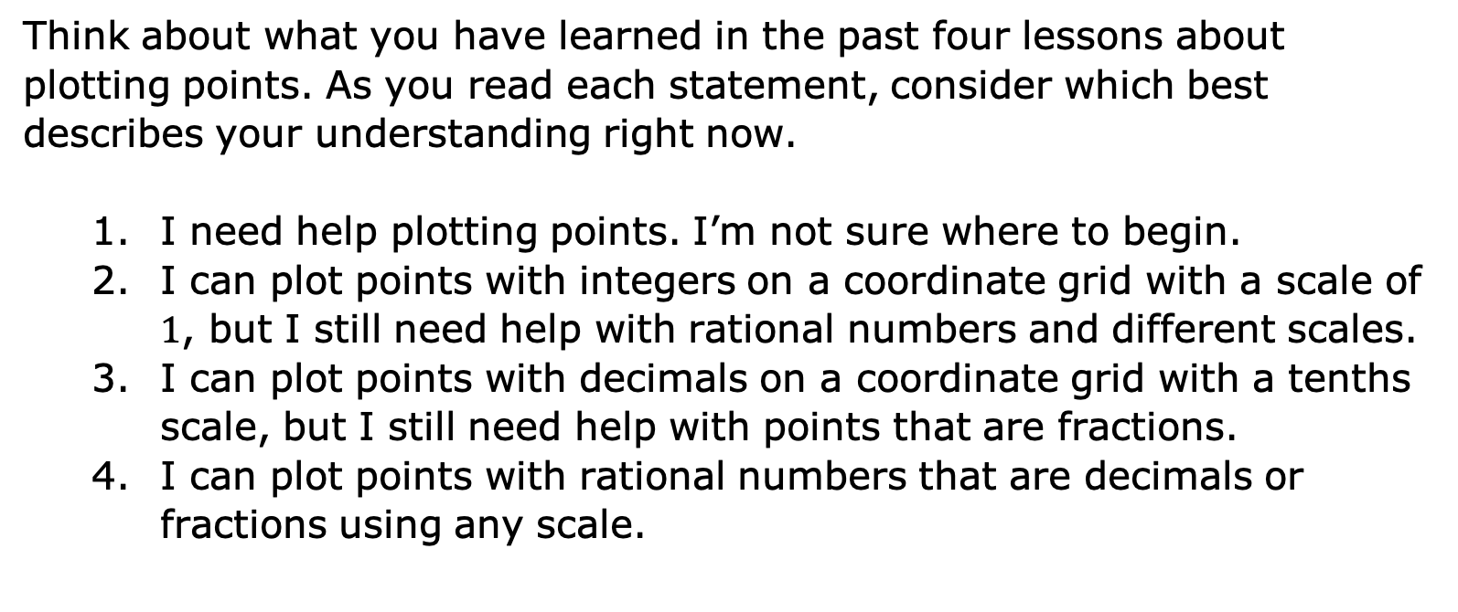
4.3.5 Wrap-Up: Reflection
Think about what you have learned in the past four lessons about plotting points. As you read each statement, consider which best describes your understanding right now.
I need help plotting points. I’m not sure where to begin.
I can plot points with integers on a coordinate grid with a scale of $1$, but I still need help with rational numbers and different scales.
I can plot points with decimals on a coordinate grid with a tenths scale, but I still need help with points that are fractions.
I can plot points with rational numbers that are decimals or fractions using any scale.
volume 1, pg. 150

Slide 23

Explain which number from the list best describes you.
Write a plan for what you can do to either move to number $4$or to help a classmate move to number $4$.
volume 1, pg. 150

